Slide 1
Eco LifeStyle Agent
IBM HACKATHON PROJECT
Presented By: Nandini.B
Student name :Nandini.Banothu
College Name & Department : Malla Reddy Engineering College For Women - CSE

Slide 2
OUTLINE
Problem Statement
Technology used
Wow factor
End users
Result
Conclusion
Git-hub Link
Future scope
IBM Certifications

Slide 3
Problem Statement
Eco Lifestyle Agent The Challenge – An Eco Lifestyle Agent, powered by RAG (Retrieval-Augmented Generation), empowers users to adopt a greener lifestyle through personalized, practical suggestions. It retrieves sustainable living tips, eco-friendly product recommendations, local recycling guidelines, and government schemes from trusted environmental sources. Users can ask natural language questions such as “How can I reduce plastic use at home?” or “What are eco-friendly travel options in my city?” and receive instant, actionable guidance. The agent promotes small daily actions with big environmental impact, making sustainability easy and accessible. This AI-driven assistant fosters eco-conscious decisions, raises awareness, and helps build a more sustainable future.
Solution: An Eco Lifestyle Agent powered by Retrieval-Augmented Generation (RAG) delivers personalized, practical green-living guidance by seamlessly pulling from vetted environmental databases, product reviews, local recycling rules, and government sustainability programs. Whether you ask, “How can I cut down on single-use plastics?” or “What’s the most eco-friendly way to commute in my area?”, it instantly curates tailored tips—like swapping plastic wrap for beeswax wraps, finding nearby refill stations, choosing low-emission transport options, or applying for solar subsidies—and presents actionable steps you can implement today. By embedding small, high-impact habits into your daily routine, this AI assistant makes eco-conscious living approachable, empowering you to reduce waste, conserve resources, and contribute to a healthier planet—one simple suggestion at a time.

Slide 4
Technology used
IBM cloud lite services
Natural Language Processing (NLP)
Retrieval Augmented Generation (RAG)
IBM Granite model

Slide 5
IBM cloud services used
IBM Cloud Watsonx AI Studio
IBM Cloud Watsonx AI runtime
IBM Cloud Agent Lab
IBM Granite foundation model

Slide 6
Wow factors
Personalized Sustainability Guidance : Understands your lifestyle and offers tailored eco-friendly tips (e.g., based on your city, habits, or household size).
Smart Information Retrieval : Uses Retrieval-Augmented Generation to pull real-time info from trusted sources—like government sites, eco-blogs, and green product reviews.
Eco-Friendly Product Recommender : Suggests verified sustainable products (e.g., biodegradable cleaning items, reusable containers, low-energy appliances) with purchase links or local store availability.
Local Recycling & Disposal Guidelines : Gives hyper-local information on how to recycle or dispose of items like e-waste, batteries, or plastic wrappers according to your municipality's rules.
Natural Language Understanding : Supports everyday language queries like “What can I do with old clothes?” or “How to compost in an apartment?”

Slide 7
End users
Environment Researchers
Eco-Conscious Individuals
NGO’s
Educators

Slide 8
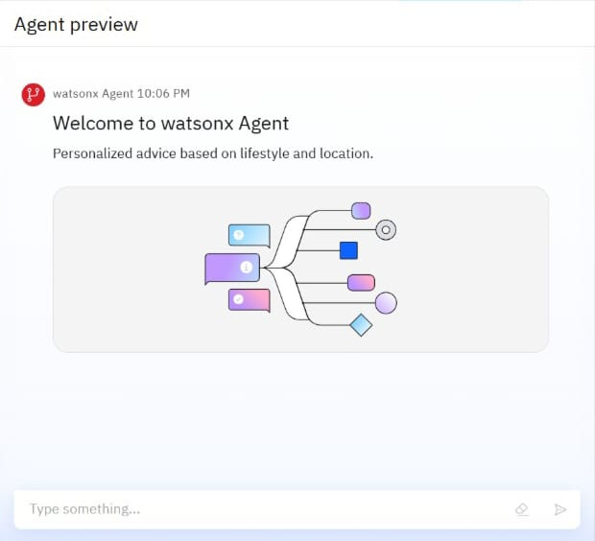
Results

Slide 9
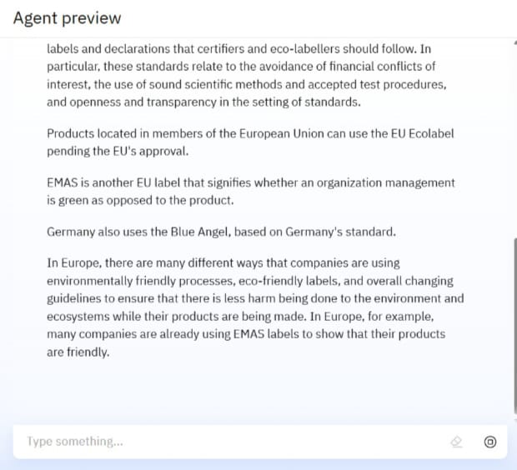
Results

Slide 10
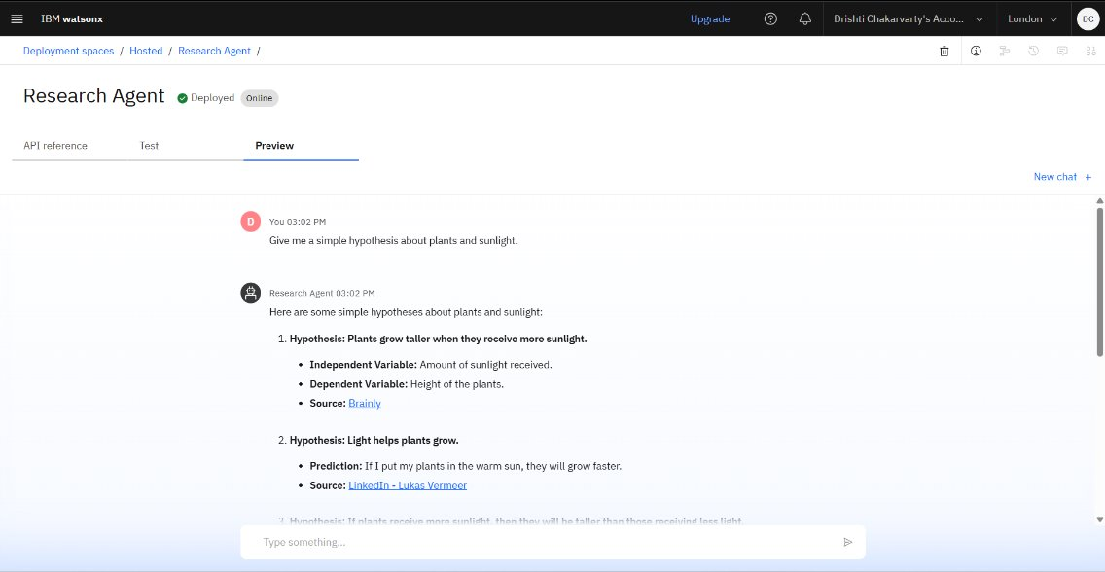
Results
Deployed AI Agent

Slide 11
Conclusion
Personalized, Actionable Guidance: The Eco Lifestyle Agent provides tailored, easy-to-follow tips and product suggestions to help users seamlessly adopt greener habits in daily life.
Trusted, Localized Information: By using Retrieval-Augmented Generation (RAG), it pulls up-to-date content from reliable sources, including local recycling rules, government schemes, and eco-resources.
Empowering Sustainable Living: It fosters long-term eco-conscious behavior by making sustainability accessible, practical, and impactful for individuals, families, and communities.

Slide 12
GitHub Link
Make sure that there should be readme file

Slide 13
Integration with Smart Home Devices
Sustainability Analytics Dashboard
Eco-Friendly Marketplace Integration
Mobile App & Wearable Expansion
Multilingual & Voice Assistant Support
Community & Social Features
Future scope

Slide 14
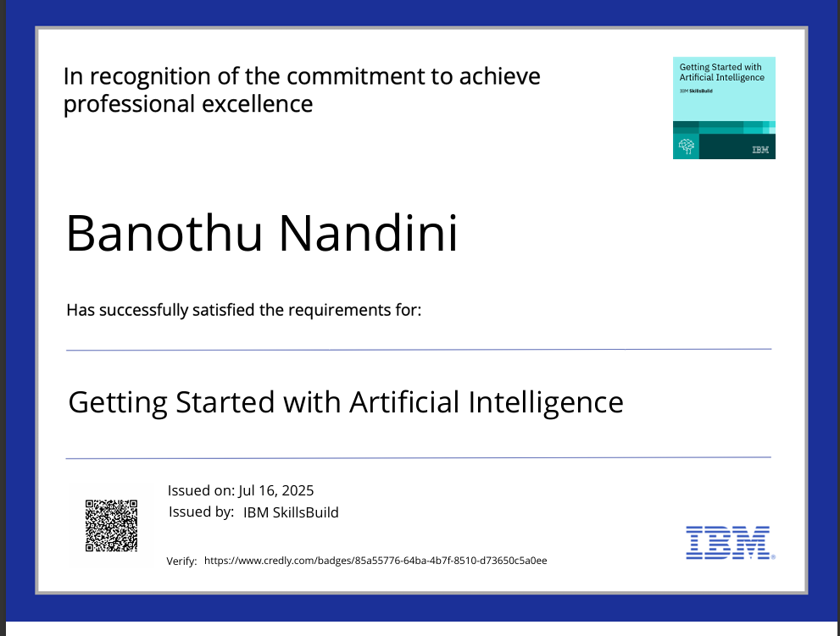
IBM Certifications

Slide 15
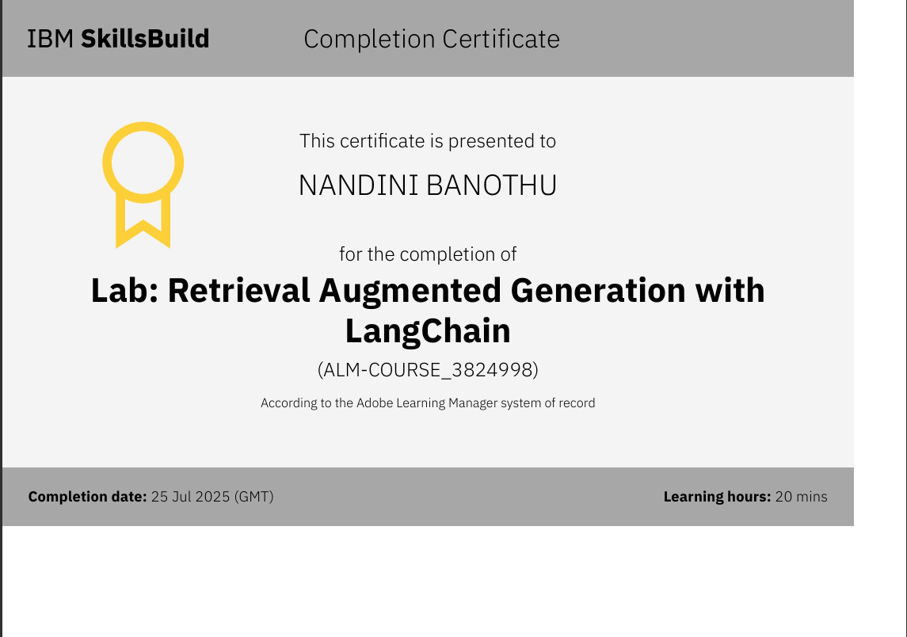

Slide 16
THANK YOU

